Slide 1
THE IMPACT OF AMORPHOUS-CRYSTALLINE CONTENT ON THE HYDRATION KINETICS OF A MODIFIED-BOF SLAG
PAVEL LEONARDO LOPEZ GONZALEZ
Prof. BART BLANPAIN
Prof. YIANNIS PONTIKES

Slide 2
Presentation outline
Motivation
BOF modification
Early kinetics study
Findings discussion

Slide 3
Motivation

Slide 4
“One of the main concerns of recent years is the high consumption of non-renewable resources followed by the CO₂ emission that is the most cause of global warming and part of this emission comes from cement production.”
“The recent concerns (…) about the reduction of three worldwide problems, which are high CO₂ emissions, the use of nonrenewable raw materials, and energy consumption, have increased the investigation of new sustainable and environmentally friendly materials. In building construction, these concerns are related to the current widespread use of portland cement …”
S. Seifi, N. Sebaibi, D. Levacher, M. Boutouil, Mechanical performance of a dry mortar without cement, based on paper fly ash and blast furnace slag, Journal of Building Engineering 22 (2019) 113–121.
J.C.B. de Moraes, M.M. Tashima, J.L.P. Melges, J.L. Akasaki, J. Monzó, M.V. Borrachero, L. Soriano et al., Optimum Use of Sugar Cane Straw Ash in Alkali-Activated Binders Based on Blast Furnace Slag, J. Mater. Civ. Eng. 30 (2018) 4018084.
“Cutting down on cement use would not only reduce CO₂ emissions and slow down the greenhouse effect but also promote energy conservation. (…) developing supplementary cementitious materials and promoting the utilization of industry by-products can effectively benefit the conservation of limited natural resources and CO₂ reduction”
“Their addition to cement production allows reduction of energy consumption and the levels of CO₂ released, by partially replacing the clinker without pre-burning treatment, since its use requires only to grinding. According to Tsai et al., the addition of 10% of the steel slag to Portland cement can reduce 9–10% CO2 emission.”
W.-T. Lin, C.-J. Tsai, J. Chen, W. Liu, Feasibility and Characterization Mortar Blended with High-Amount Basic Oxygen Furnace Slag, Materials (Basel, Switzerland) 12 (2018).
S.Z. Carvalho, F. Vernilli, B. Almeida, M.D. Oliveira, S.N. Silva, Reducing environmental impacts: The use of basic oxygen furnace slag in portland cement, Journal of Cleaner Production 172 (2018) 385–390.
Source: www.flickr.com/photos/nasacommons/albums/72157650236003648

Slide 5
Motivation
“It’s a simple issue.
We need to stop emissions of greenhouse gases. Either we do that or we don’t. Either we prevent 1.5 degrees of warming, or we don’t.
There are no grey areas when it comes to survival.
Adults like to say that they want to give their children hope. I don’t want your hope. I want you to panic. I want you to feel the fear I feel every day.
I want you to feel as if the house is on fire, because it is.”
Greta Thunberg in Davos 2019
Source: Fabrice Coffrini/AFP/Getty Images

Slide 6
My material: Modified basic-oxygen furnace (BOF) slag

Slide 7
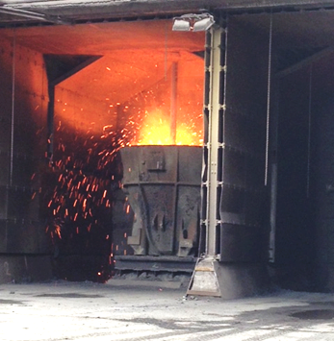
BOF - Facts
Secondary material generated during steel production
Between 120 and 240 Mton in 2016¹ (100 to 200 kg per steel ton)²
Reutilization rates:
Europe >80%³
China ~20%⁴
Constrains:
Volume expansion
Legislation
¹World steel association. World steel in figures 2017. [October 05, 2017]; Available from: worldsteel.org.
²Mahieux P-Y, Aubert J-E, Escadeillas G. Utilization of weathered basic oxygen furnace slag in the production of hydraulic road
binders. Construction and Building Materials 2009;23(2):742–7.
³Euroslag. Statistics (2016) [October 12, 2018]; Available from: https://www.
euroslag.com/products/statistics/2016/ (Web reference).
⁴Yi H, Xu G, Cheng H, Wang J, Wan Y, Chen H. An Overview of Utilization of Steel Slag. Procedia Environmental Sciences 2012;16:791–801.

Slide 8
Slag processing
BOF compositional modification and mineralogy after processing
P.L. Lopez Gonzalez, R.M. Novais, J.A. Labrincha, B. Blanpain, Y. Pontikes, “Modifications of basic-oxygen-furnace slag microstructure and their effect on the rheology and the strength of alkali-activated binders”, Cem Concr Compos 97 143–153 (2019).

Slide 9
Modified slag
+
The modified slag was highly reactive when alkaline solutions were used as activator.
Direct hydration was possible

Slide 10
Let’s consider the granulation. Is there a difference among size fractions?

Slide 11
Mineralogy of different size fractions
Particle size distribution, the sieve apertures (1.0 and 1.6 mm) used to split into three size fractions is indicated
Quantified mineralogy of BOFS fractions
P.L. Lopez Gonzalez, Y. Pontikes, “Microstructural tailoring of BOF steel slag for construction applications: amorphous content and its impact on reactivity and mechanical strength after alkali activation”, in Proceedings 7th International Conference on Engineering of Waste and Biomass Valorisation (WasteEng18), edited by P.S. A. Nzihou, 2018.

Slide 12
Yes, there is a difference. What is the impact during hydration?

Slide 13
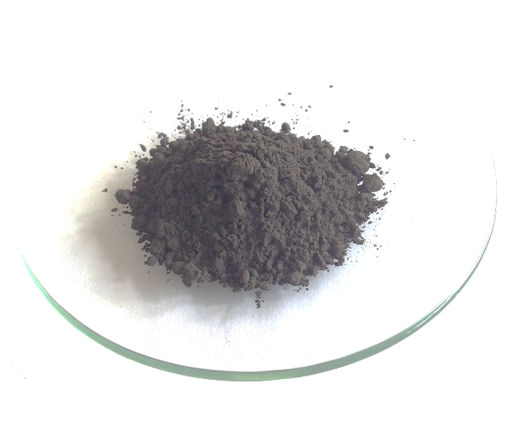
Early reaction study
Calorimetry – admix ampoule
XRD in situ during the first 2 hours
FTIR during the first hour
Compressive strength after 7 days
4500 cm²/g (± 5 %)

Slide 14
Early hydration kinetics
F1 and F2: Three distinctive stages with the main peak occurring after 8 h.
F3: Unimodal with a single peak appearing after 4 h
The total heat released after 72 h: 333 J/g for F1, and 322 J/g for F2 and F3.
Source: www.tainstruments.com/new-tam-air/
Heat flow and total heat released by the hydrated size fractions, W/S=0.4

Slide 15
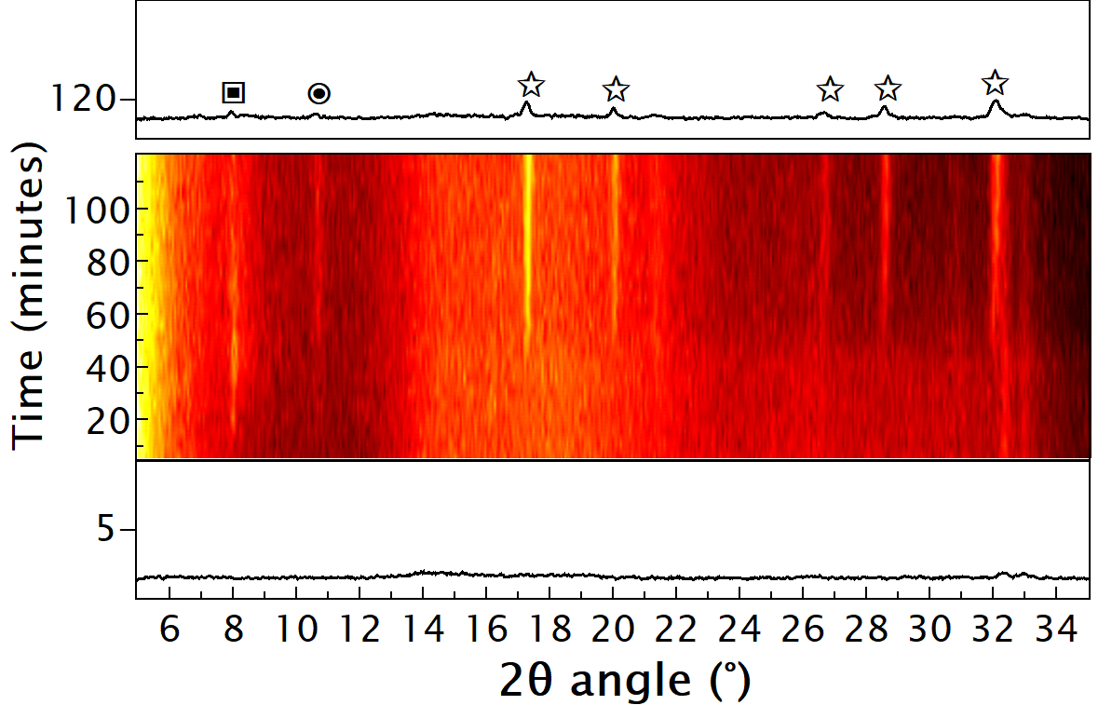
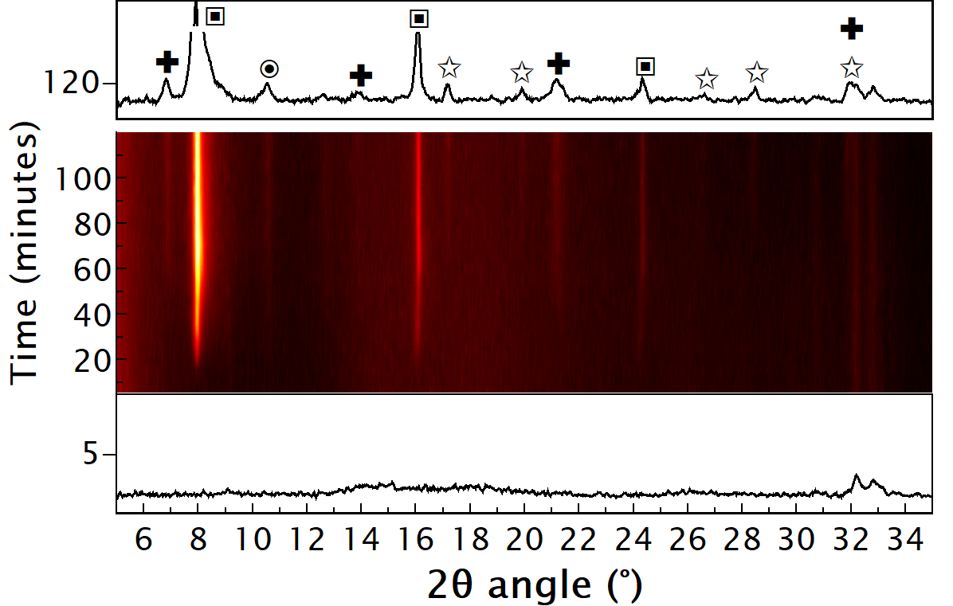
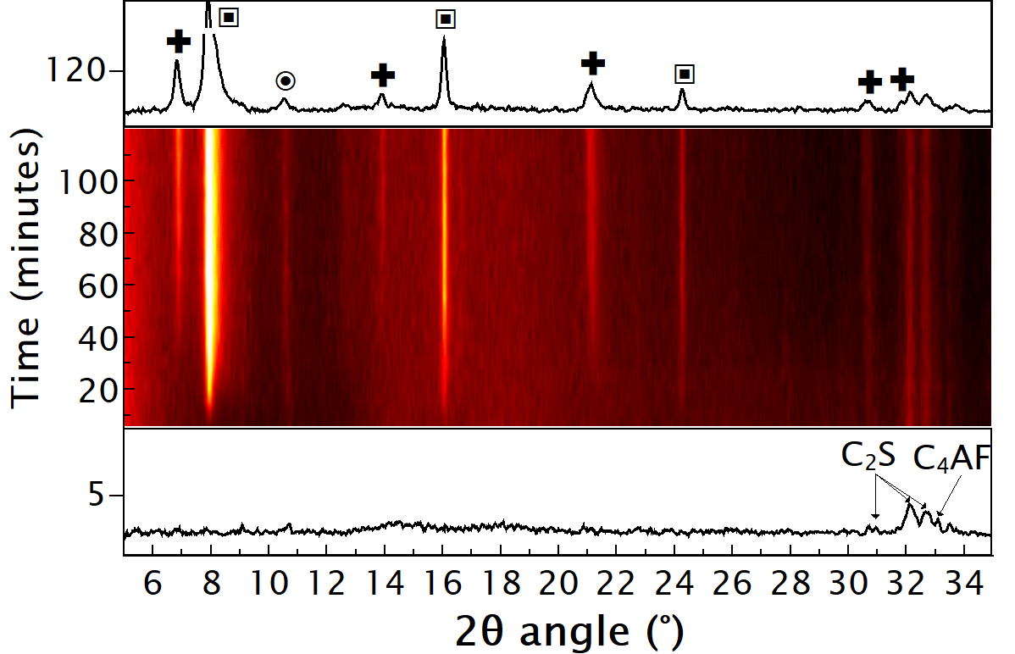
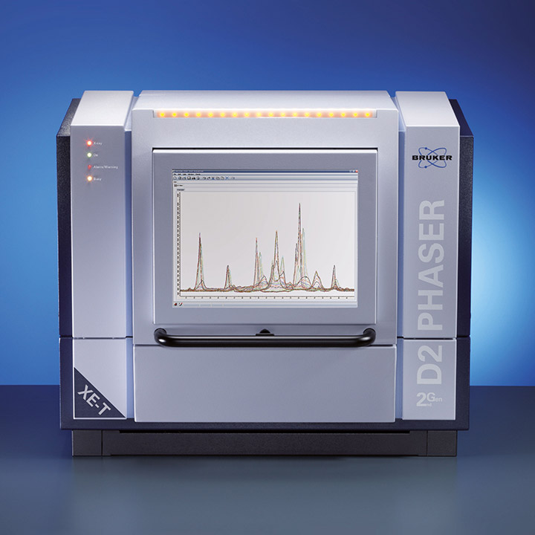
Early hydration products
10 minutes: C₂(A,F)H₈ and C₄(A,F)H_{x}, linked to C₄AF hydration in all fractions
40 to 50 minutes: katoite in F1, strätlingite (Ca₂Al₂SiO₇∙8H₂O) in F3, and both types in F2
F1
F2
F3
In-situ XRD for the first 2 h of hydration of slag fractions brighter colour indicates sharper features.
Source: www.bruker.com/es/products/x-ray-diffraction-and-elemental-analysis/x-ray-diffraction/d2-phaser/overview.html
Cross: Strätlingite, Ca₂Al₂SiO₇∙8H₂O - Square:C₂(A,F)H₈ - Circle: C₄(A,F)H_{x} - Star: Katoite, Ca₃Al₂(SiO₄)_{3-x}(OH)_{4x} with x=1.5-3

Slide 16
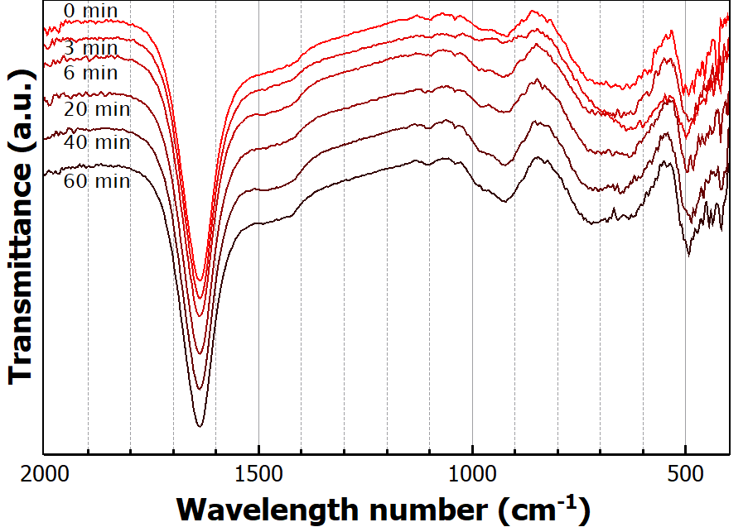
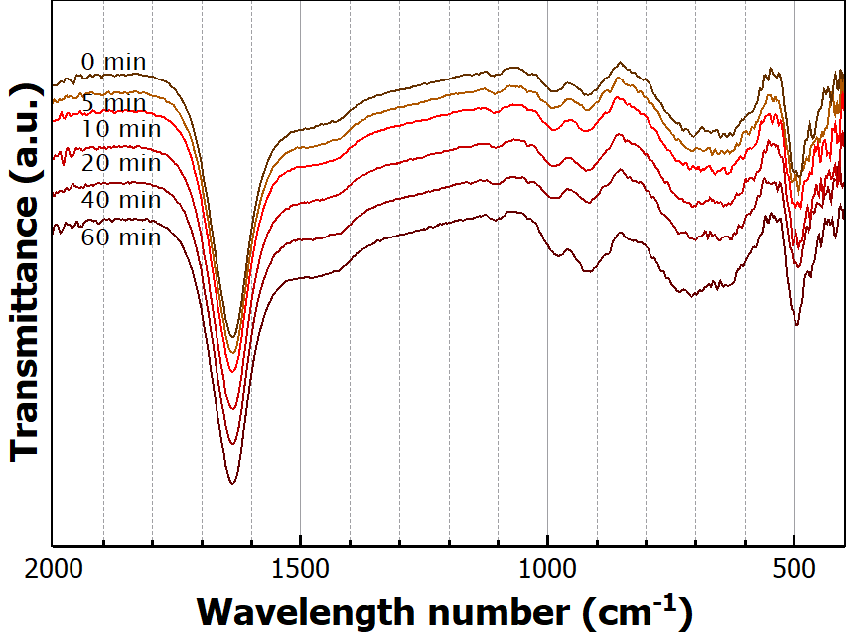
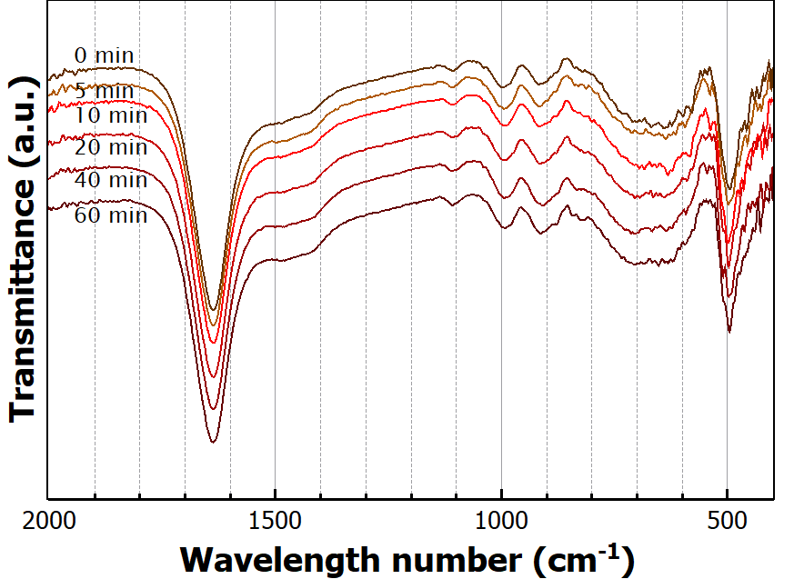
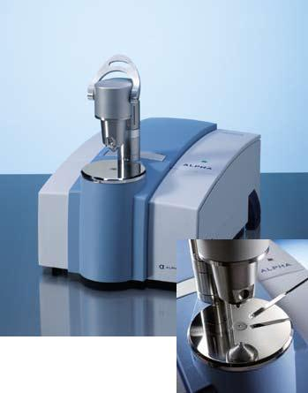
Early hydration
Time 0: Presence of unreacted C₂S, and calcium-aluminium rich phases.
60 min: Peak increase in F1 and F2 samples, compatible with the formation of katoite
OH bending
F1
F2
F3
Infrared spectra of fractions during the initial 60 minutes of hydration
Source: www.azom.com/article.aspx?ArticleID=5957

Slide 17
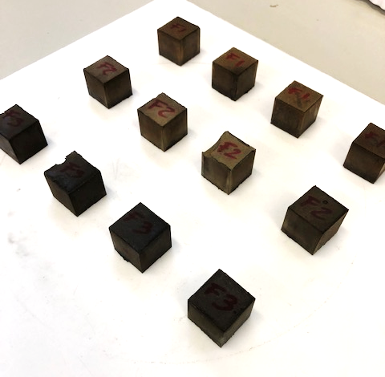
Early mechanical strength
F3 developed 17.5 MPa on average and is higher than the values obtained for F1 and F2 (12.2 and 13.0 MPa respectively).
Strength increase for F3: 43% and 35% relative to F1 and F2 respectively.
Compressive strength after 7 d of pastes produced using BOFS fractions

Slide 18
There is an effect on the hydration kinetics and the properties at early stage

Slide 19
Findings

Slide 20
To keep in mind
Granulation produced differences in mineralogy that impacted the kinetics of hydration and the strength developed by paste specimens after 7 d.
Early kinetics are driven by of the fast-reacting calcium-aluminoferrite phases.
The formation of katoite can be explained as the conversion of the initial hydration products into more stable forms.
The differences on the strength developed can be direct consequence of the kinetics.
Amorphous fraction might be playing a big role (currently under investigation)
Further characterization of main reaction product (gel) can provide the answer.

Slide 21
Sieving is a potential tool to further tailor kinetics and early strength of granulated BOFS binders

Slide 22
Thank you!

